Slide 1
ENOS a structure that:
Gives visibility to outdoor sports in Europe
Encourages the best outdoor practises and experiences
Develops international collaboration in outdoor sports
ENOS: Developing, promoting, managing and representing outdoor sports across Europe
ENOS is a member of R.E.D.
Further info : www.nature-sports.eu

Slide 2
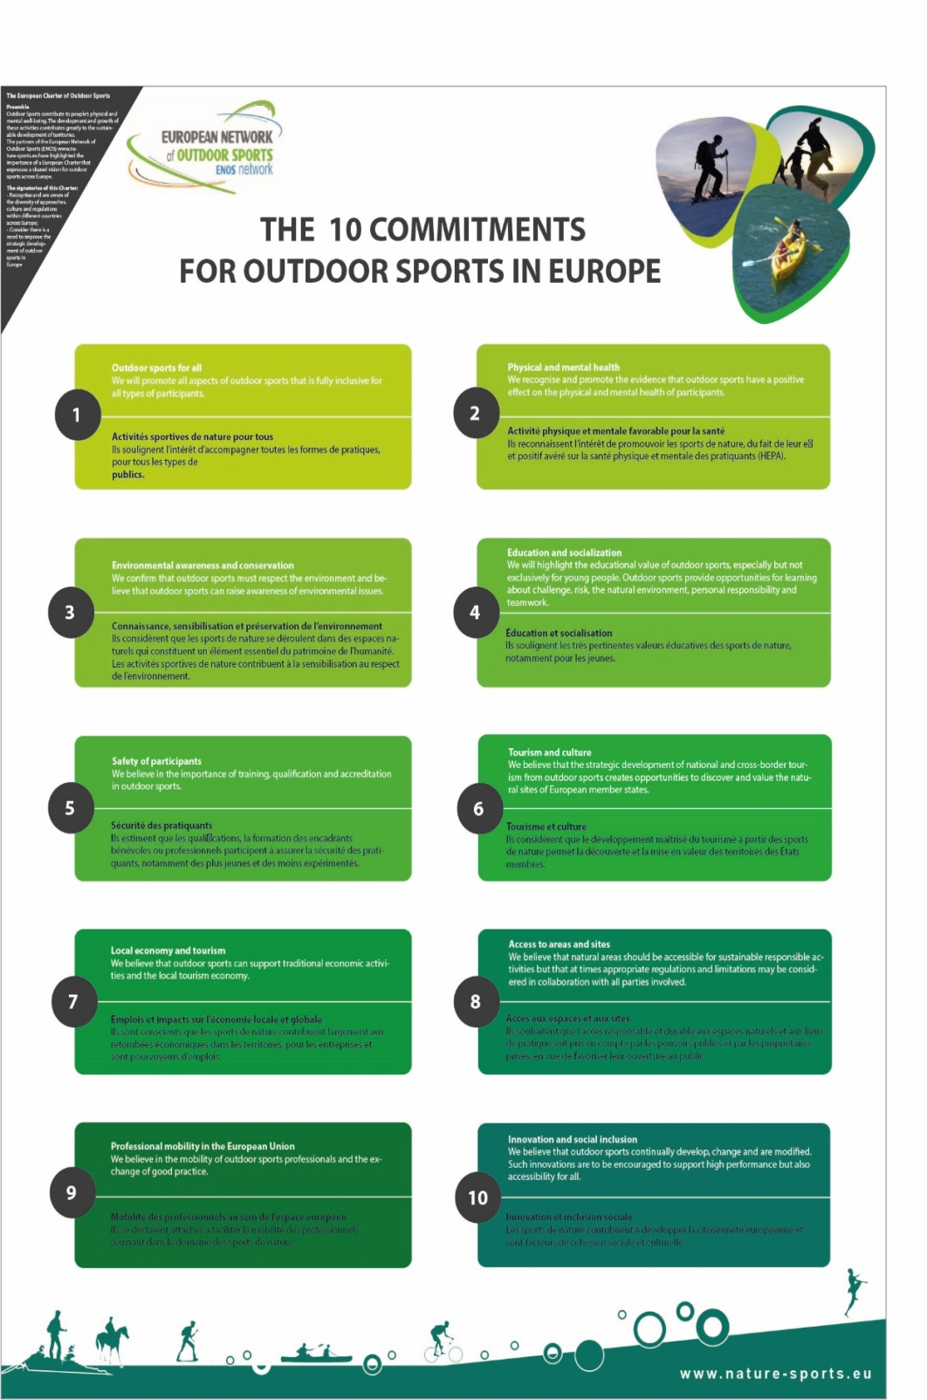
ENOS – charter
Notes:
ENOS promotes the value of outdoor spaces and the activities that take place in them to the EU commission. ENOS developed a charter¹ that highlights the key sustainability and socioeconomic factors that any organization promoting outdoor sports and recreation needs to think about

Slide 3
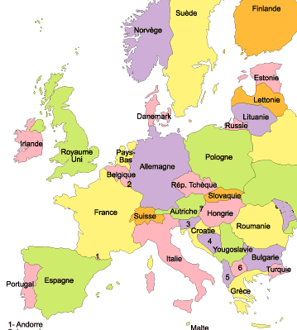
Germany
Technische Universität München
UK
Sheffield Hallam University
UK
Sport Northern Ireland
France
UCPA
ENOS – Board
France
F.F. d’Equitation
France
CREPS
Portugal:
High Performance Center Surf; Viana do Castello
Spain:
Institut National d'E.F. de Catalunya
Bulgaria:
University Sofia

Slide 4
Project « Pôles de pleine nature » en Massif Central 2015 / 2016

Slide 5
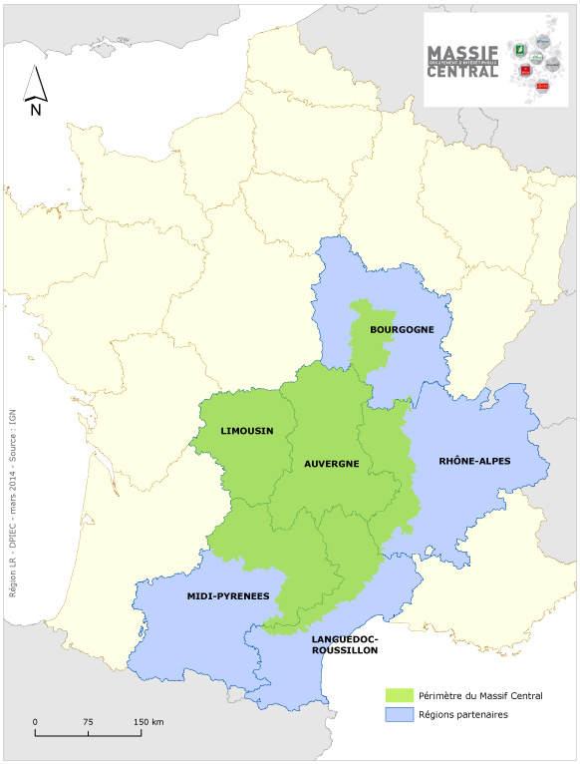
Massif Central
85 000 km2, size of Austria.
Part of 4 « new » regions.
3,8 million people
Forest, lakes, grasslands, mountains… The Massif Central represents a great natural and cultural heritage.
It includes 10 Regional Parks and 1 National Park.

Slide 6
Outdoor Resorts in the Massif Central – Issues and challenges
Massif Central : active and inhabited massif
Goal : development in rural areas, outdoor activities, a tool for local vitality
Key words : inclusion, sustainable local development, education,
Outdoors resorts : private / public partnership
Project leader for each outdoor resorts : local communities, in rural area
Fundings: 1,5 M€ per project
500 000€ FEDER
500 000€ State / region
30 to 40% local authority, public or private
Eligible costs : salary for project manager or animator, services, studies, investissments and material
17 projects selected and funded – 5 years time

Slide 7
Outdoor Sport Resorts - Pôles de pleine nature –
Morvan
Grand Gueret
Crêtes du Forez
Les Cheires
Monts du Forez
Grand Sancy
Beaujolais Vert
Brive
Pilat
Montagne ardéchoise
Aubrac 4 Saisons
Causse du Quercy
Mont Lozère
Midi- Quercy
Mont Aigual
Montagne du Carroux

Slide 8
Outdoor Resorts in the Massif Central
Criteria:
Diversified activities
Governance, project manager, education courses
Sustainability, environment, quality, landscape
Safety and quality of the offer, public
Connections of the project : health, culture, history
Commercialization
Call of project - governance :
GIP Massif Central – « Groupement d’Interet Public »
CGET – (ex DATAR) National Agency for territorial development
The CREPS Rhône Alpes – Outdoor National Center as adviser and outdoor specialist
Notes:
Enjeu : viser un modèle économique pérenne et donc optimiser les recettes : une offre qualifiée, visant plusieurs disciplines, plusieurs niveaux, plusieurs saisons.
Le partenariat est un élément majeur pour permettre la mise en ouvre d’une stratégie globale dans le temps; une structure fédératrice doit être garante de cette stratégie.
L’approche environnementale est essentielle pour pérenniser la qualité du/des sites, élément indissociable de la qualité de l’offre.
Un réseau de professionnels : qualification de l’offre, approche « emplois ».
Une offre touristique pour inscrire le pôle dans une destination permettant une complémentarité de l’offre : offre nature, « bien-être et remise en forme », culture/ patrimoine.
Autre enjeu majeur : aller jusqu’au bout du processus de développement et viser une mise en marché / mise en produit.

Slide 9
Outdoor Resorts in Massif Central
Project evaluation – Starting 2017 :
A toolkit is provided : mesure the outdoor activity
Evaluation of the number of jobs created
Evaluation of the economic impact.
Interest and difficulties of the project
Interest:
technical support of the National Outdoor Center to provide sustainable activities and training courses
Consistency and coherence of the project
Difficulties:
Finding local project managers or installing someone
Most of the selected projects come from areas that are already priviledged

