Slide 1
European Destinations of Excellence - EDEN project EDEN NETWORK AISBL 16 February 2017 - BERGAMO
Notes:
1

Slide 2
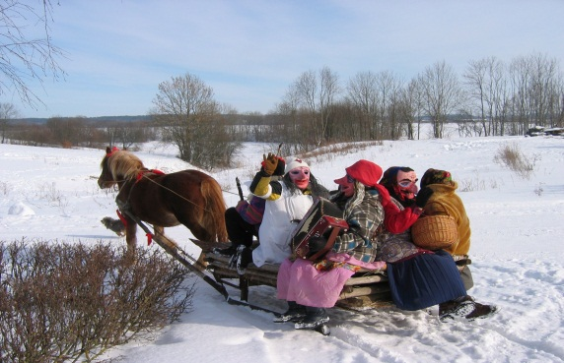
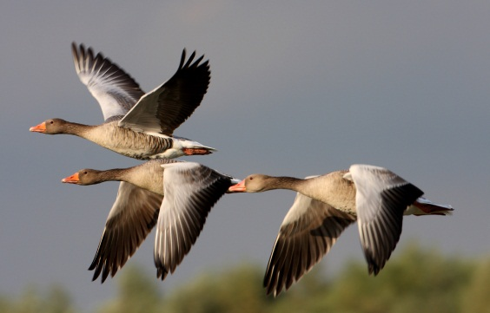
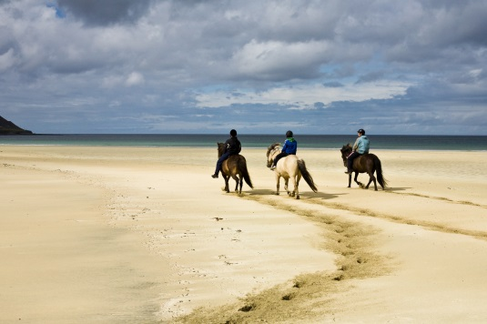
EDEN initiative
Launched by the European Commission in 2006
promotes sustainable tourism destination models
awards and promotes the best destinations of excellence in Europe
Adresses concerns of sustainability, seasonality, rebalancing tourist flows towards non-traditional destinations, networking of stakeholders, etc.

Slide 3
Participating countries
2007: 10
2008: 20
2009: 22
2010: 25
2011: 21
2013: 19
2015: 20
2017: 18
27 countries:
Austria, Belgium, Bulgaria, Croatia, Cyprus, Czech Republic, Estonia, Finland, France, Germany, Greece, Hungary, Iceland, Ireland, Italy, Latvia, Lithuania, Luxembourg, Malta, the Netherlands, Poland, Portugal, Romania, Serbia, Slovenia, Spain and Turkey

Slide 4
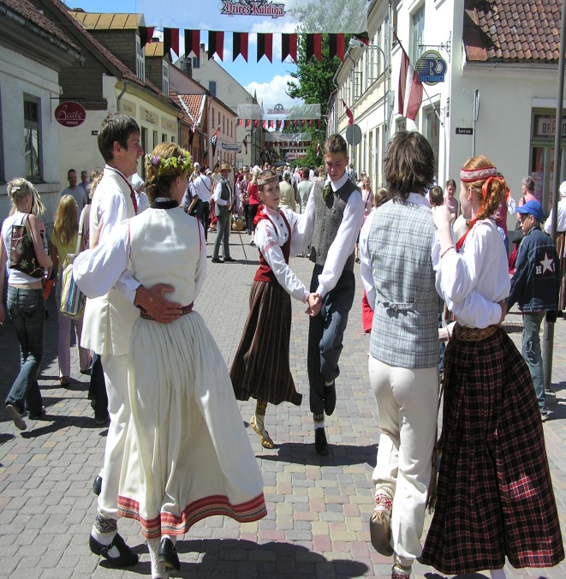
EDEN themes 2007 – 2017
2007: best emerging rural destinations
2008: tourism local intangible heritage
2009: tourism and protected areas
2010: aquatic tourism
2011: regeneration of physical sites
2013: accessible tourism
2015: tourism and local gastronomy
2017: cultural tourism

Slide 5
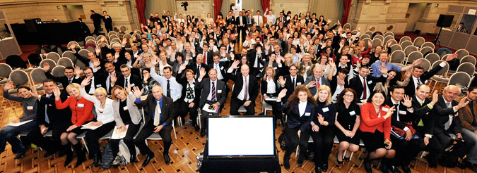
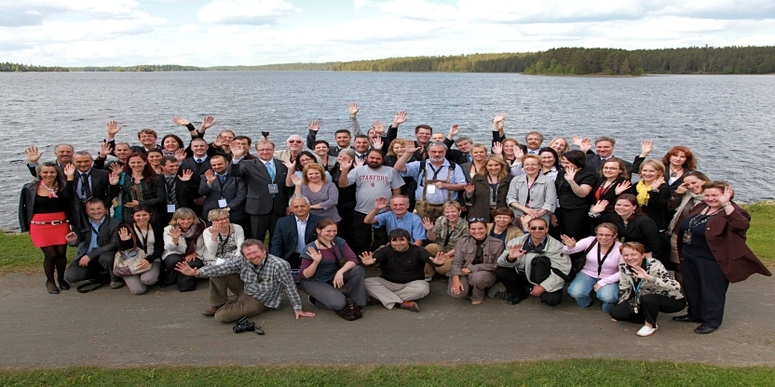
EDEN NETWORK
A unique network in the field of sustainable tourism worldwide: over 500 destinations (winning destinations and runners-up)
A platform for the exchange of good practices in the field of sustainable tourism at European level and to promote networking between awarded destinations
EDEN Network Association established in 2012 provides further networking benefits to its members 68 destinations / 500 from 23 countries.

Slide 6
EDEN VALUE PROPOSITION
EDEN NETWORK
"VALUE PROPOSITION"
CREATING MASS
"...considering the increased competition, and continually growing range of places to visit, networking multiples opportunities to make destinations known, especially the small ones..«
COST SHARING
"...networking also means sharing costs among multiple destinations, allowing for example to create professional websites at lower costs, possibility to access chaper training courses, cost effective advisory services.......«
KNOWLEDGE SHARING
"...opportunty to share good practice, making new destination management models easy to learn and therefore increasing the opportuntiy to improove quality of of the tourism offer...«
FACILITATING PLATFORM
"...a network coordinated by a professional organizzation (Association) provides a one -stop shop for relevant stakeholders who want to contact multilple actors making easy buillding valuable realatiohnships..."

Slide 7
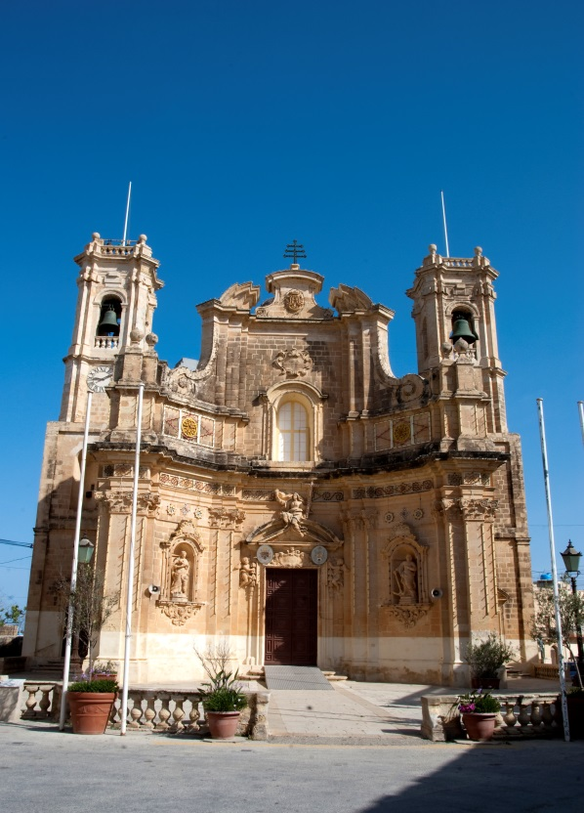
2017 edition: Cultural tourism
Cultural tourism accounts for +/-50% of all European tourism
Focus on local tangible cultural assets: cultural-historical heritage, monuments, historial sites, museums, galleries, contemporary architectural sites, etc.
Procedure:
Call for proposals published in July 2016
EC evaluation of proposals until December
Grant agreements signed in February 2017
Implementation: February – December 2017
National Award ceremony: end of 2017
EU Award ceremony: 1st quarter 2018

Slide 8
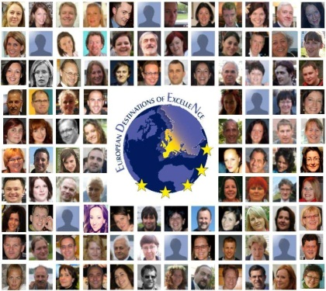
Contact details
European Commission - Tourism website:
http://ec.europa.eu/growth/sectors/tourism/index_en.htm
European Commission - EDEN webpage:
http://ec.europa.eu/eden/
EDEN mailbox:
GROW-EDEN@ec.europa.eu
Miralda Cortinovis

