Slide 1
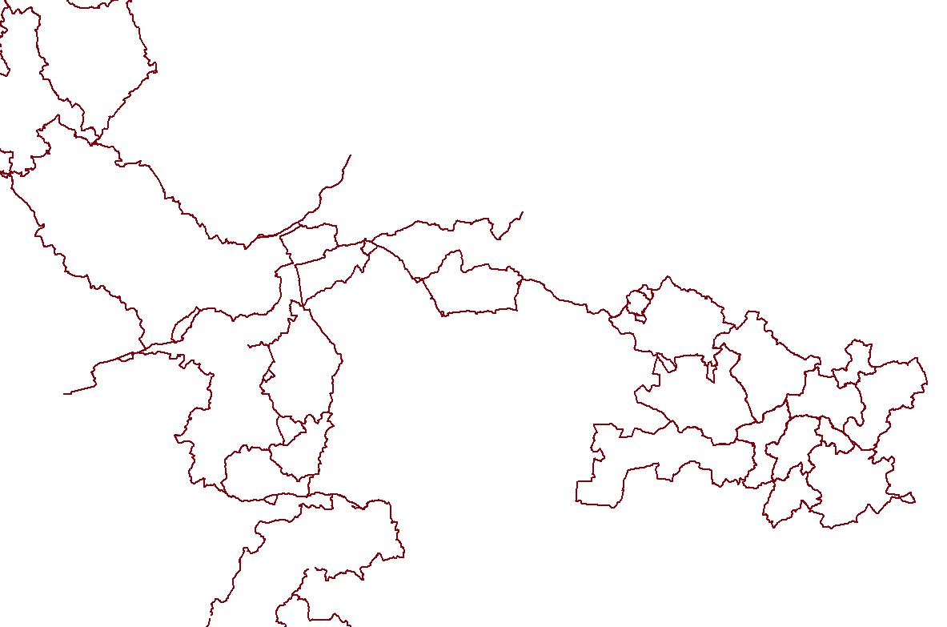
GIS project of digitization of Equestrian Tourism routes
Fédération Française d’Equitation
Geographical Information System (GIS)

Slide 2
The FITE and the FFE
The Fédération Internationale du Tourisme Equestre (FITE):
Created in 1975
21 National Equestian Tourism Organisations (ONTE) members of the FITE including the Fédération Française d’Equitation (FFE)
The aim : to organise, develop and promote Equestrian Tourism all arount the world
The Fédération Française d’Equitation (FFE) and its Tourisme department:
3rd national sports federation (700 000 members) and 1st women’s sport
2 500 establishments and horse riders associations certified
1 million km of path in France including 60 to 80 000 km of path praticables with horses
Several FFE’s quality labels : « Grands Itinéraires Equestres », « Centre de Tourisme Equestre » and « Cheval étape » for transnational equestrian routes, horse riding centres specialised in Equestrian tourism and equestrian stopovers
Development of the 1st Transnational equestrian route: « The European Route d’Artagnan »

Slide 3
Objectives of the GIS project
To promote a quality equestrian tourism offer with selection criteria
To highlight the official horse trail signage in the field:
GIS is a mangement tool with many applications:
(maps analysis, web map application, etc.)
To provide homogeneous information on the whole territory

Slide 4
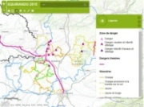
Objectives of the GIS project
Step 1
To build a cartographic database …
FFE Tourism department
Cartographic database
FFE regional
committees
Step 2
In order to make a valuation tool
Web cartographic application
Geographical database
Valorisation of Equestrian tourism routes
General public

Slide 5
GIS testing on an only one French region
Partnership between regional public tourism
institutions and FFE
Objectives :
To build the GIS database
To create work process and methodology
for the datas’handover
To focus on a little scale of work
To create a training of GPS collector of tracks
and waypoints
Spreading of the project on a national scale
since January 2017
Support to FFE’s committees in handovering their data into
the cartographic database
Reutilisation of regional methodology
Building a cartographic web application

Slide 6
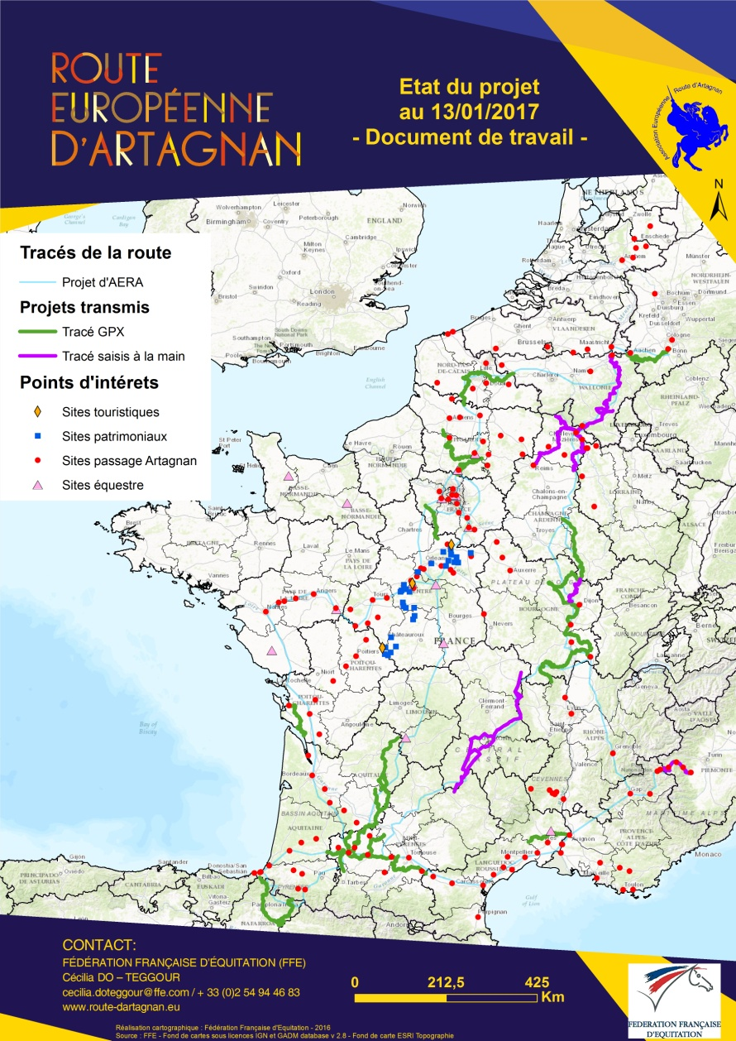
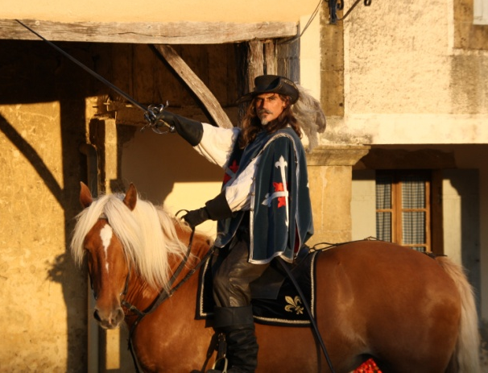
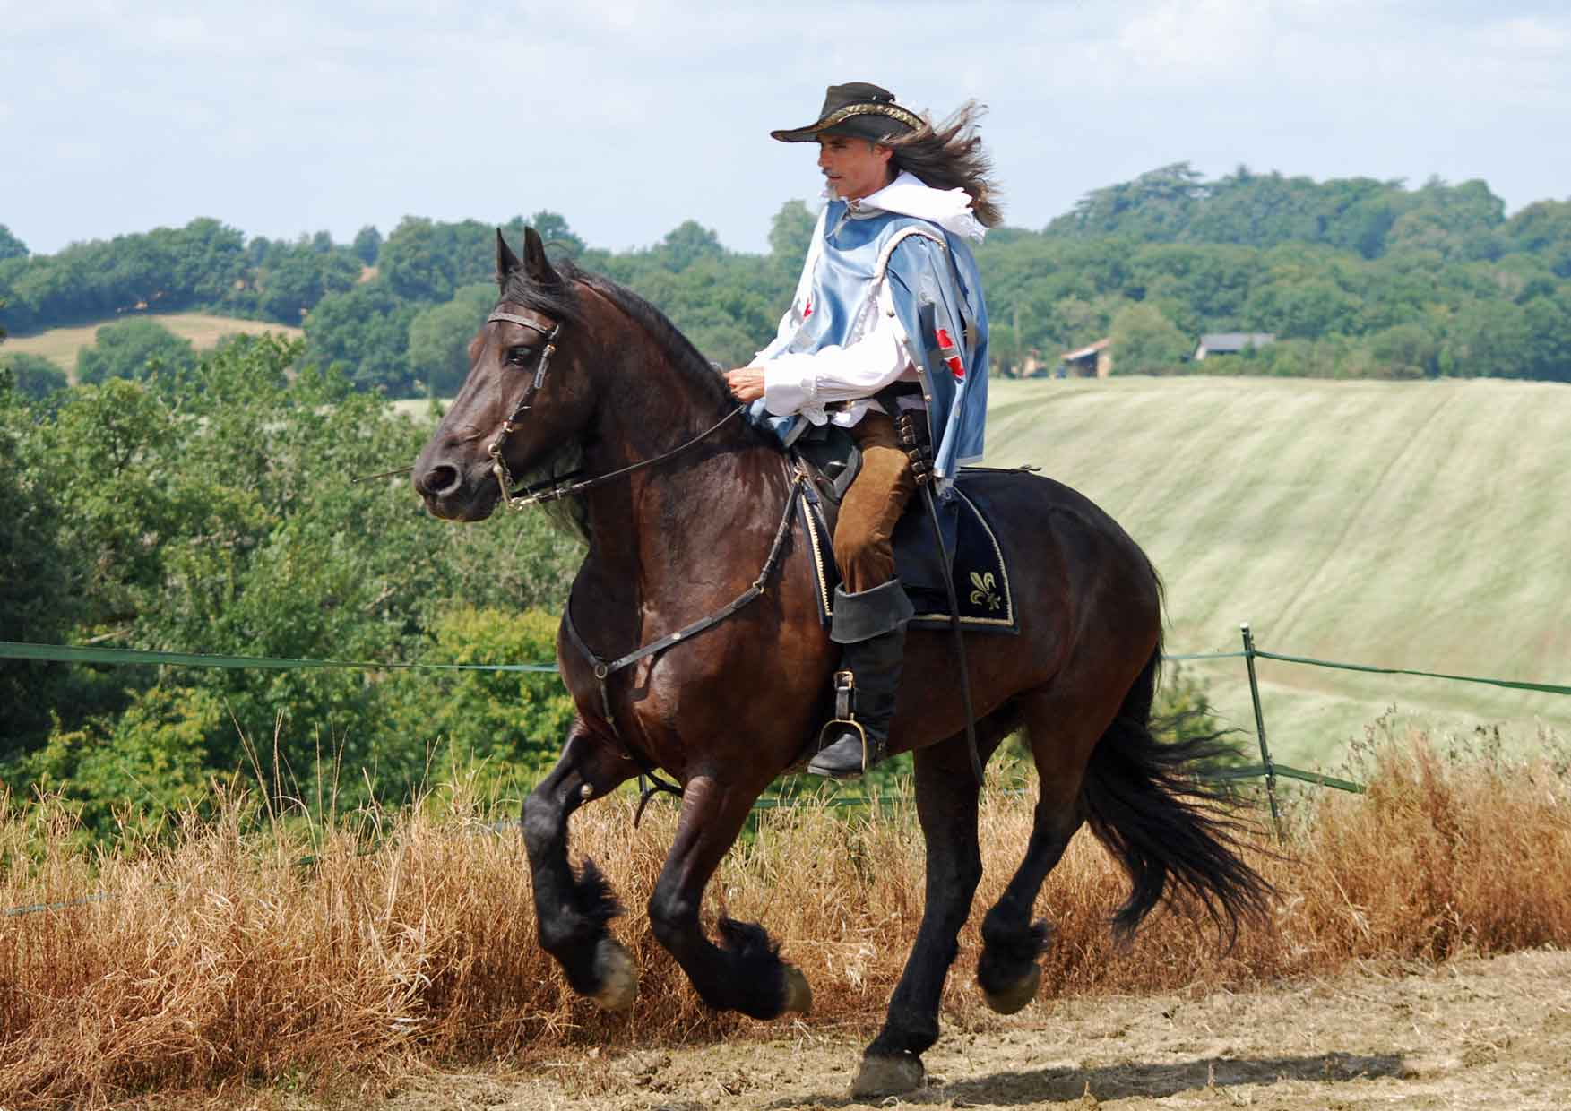
The European Route d’Artagnan
One of the use of the GIS tool:
To build a European equestrian cultural route
Participation of the FITE and the FFE to this European project
Identify where d’Artagnan was really been
Every FFE’s committees proposed an itinerary on its territory
FFE and AERA association validate the propositions
Tracks and waypoints are digitized with the GIS tool
Promotion through a web cartographic application
Continuous updating of the cartographic database

Slide 7
Thank you for your attention
FFE Tourisme – CNTE
Rémi THORET
remi.thoret@ffe.com
Tel : +33 (0)2 54 94 46 87
www.ffe.com/tourisme
FITE
info@fite-net.org
Tel : +33 (0)2 54 94 46 85
www.fite-net.org

