Slide 1

Challenges for Rural Areas: Accessibility of Tourism Services
.
ENTE FIERA PROMOBERG
Bergamo, 15 February 2019
Ivor Ambrose
Managing Director
ENAT - European Network for Accessible Tourism
Non-Profit Association.
Notes:
1

Slide 2
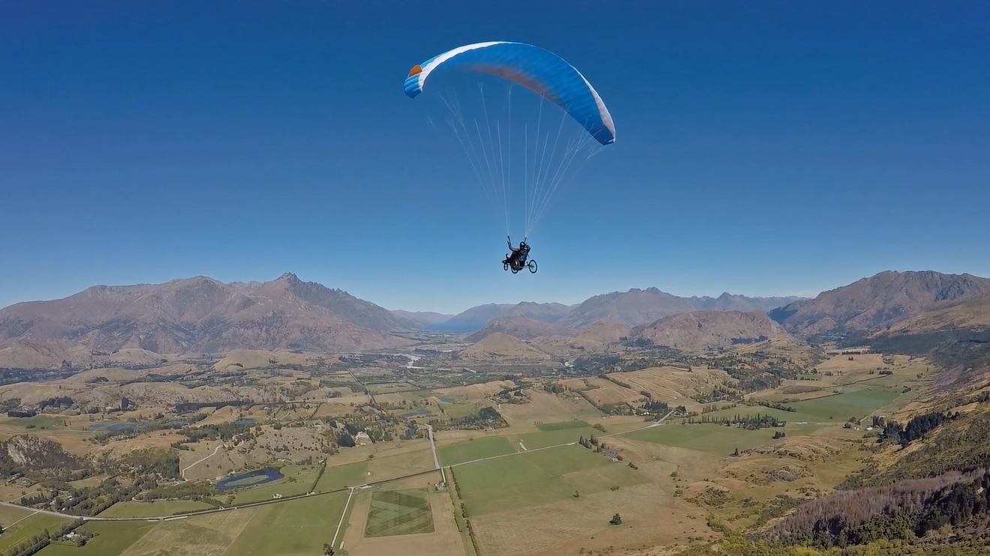
Including Everyone in Tourism
Photo: MakingTrax, NZ
Notes:
2

Slide 3
Accessible Tourism is…
“Universally Designed Tourism for All”
It’s about making environments, venues and services suitable for the widest range of customers, including:
Seniors,
Families with small children,
People with disabilities,
People with long-term health conditions
… and many more.
Ensuring equal opportunity to enjoy tourism experiences
Accessibility = Inclusion, comfort, safety, sustainability

Slide 4
Accessible Tourism is…
“Universally Designed Tourism for All”
Ensuring equal opportunity to enjoy tourism experiences
Accessibility =
Inclusion, comfort, safety, sustainability

Slide 5

Tourism – open to everyone

Slide 6
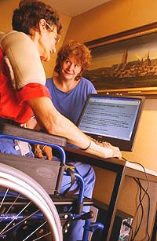
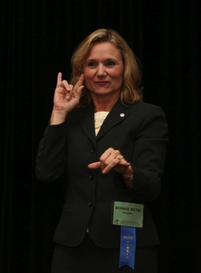
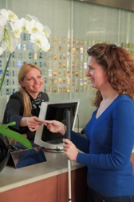
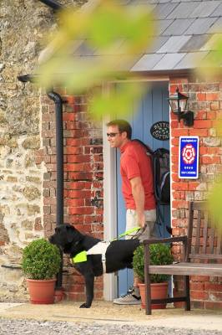

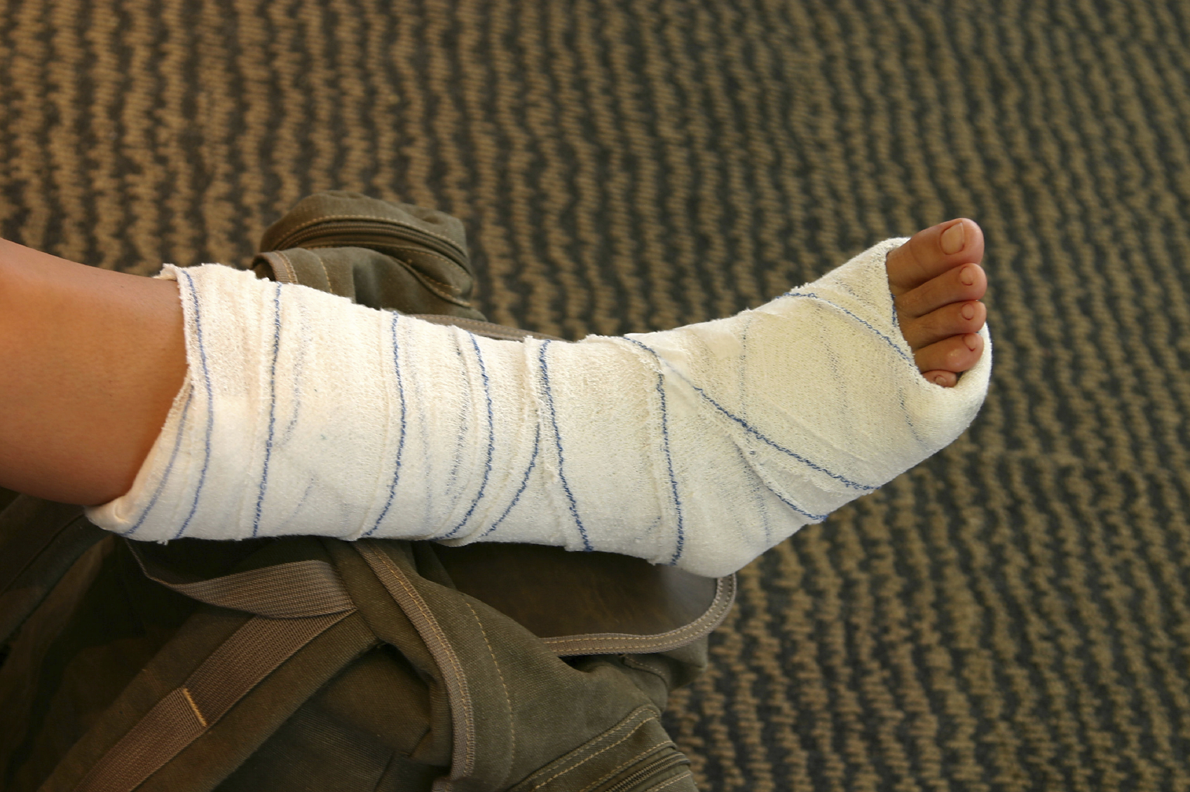
Challenges …….. Become Opoportunities
Notes:
6

Slide 7
Accessible Tourism is…
Part of every kind of offer
Accommodation
Adventure
Culture
Gastronomy
Conferences & Fairs
With kids
Education
Nature in the city
City Break
Religion
Sports & Events
Festivals

Slide 8
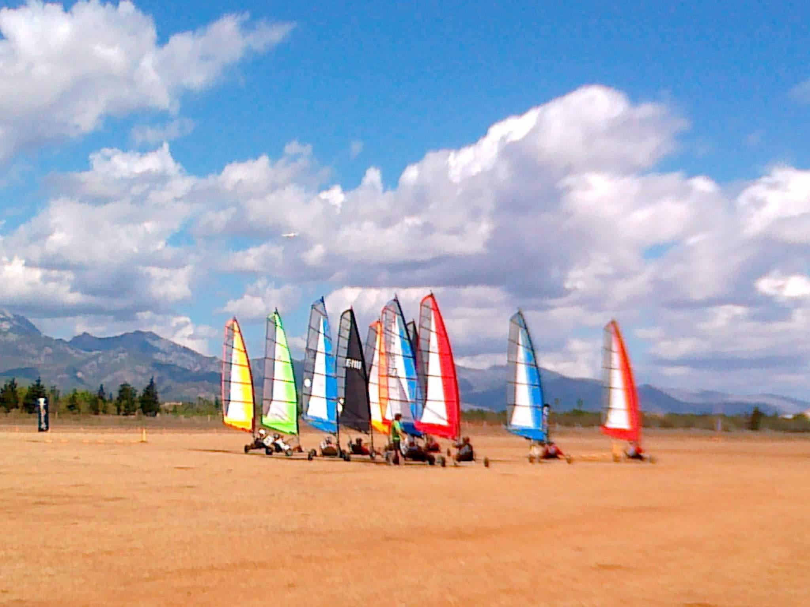
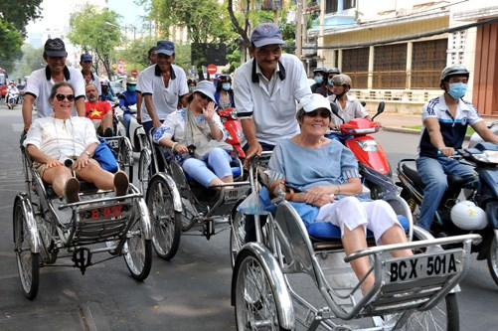
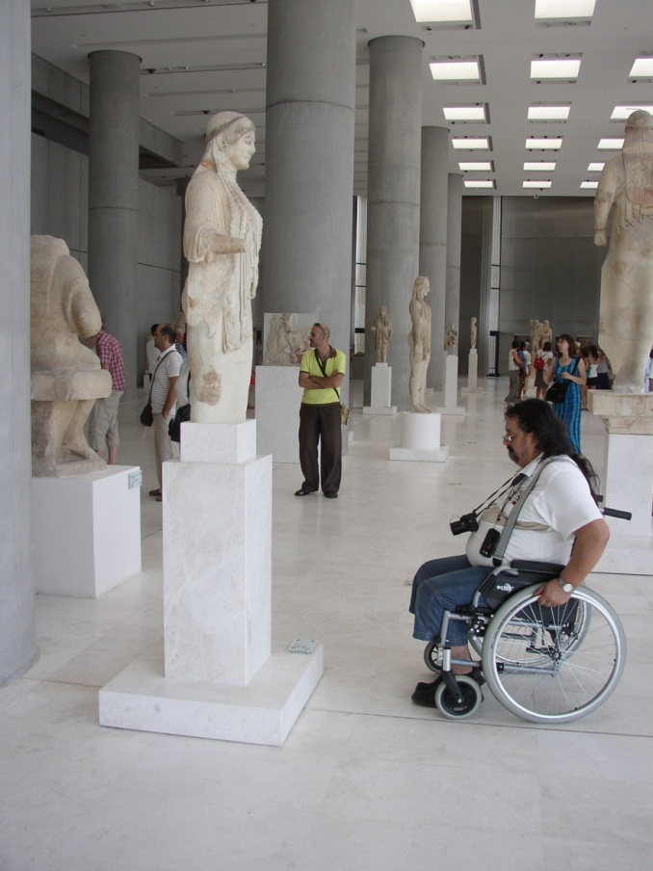
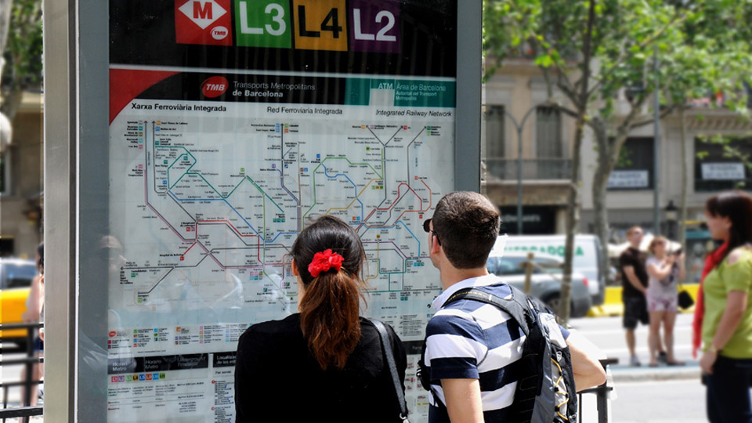
Tourism for All

Slide 9
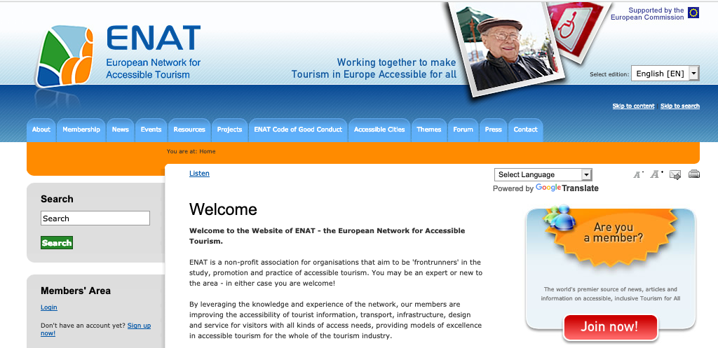
Visit: www.accessibletourism.org

Slide 10



https://Pantou.org
The Accessible Tourism Directory

Slide 11
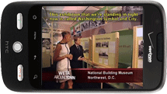
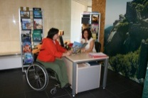
Developing the tourism supply chain:
…the 4 essentials
Accessible…
Information - search, bookings, Websites,
mobile applications…
…throughout the entire delivery chain

Slide 12
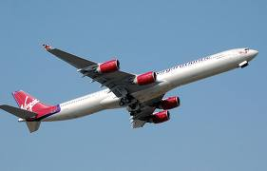
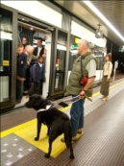
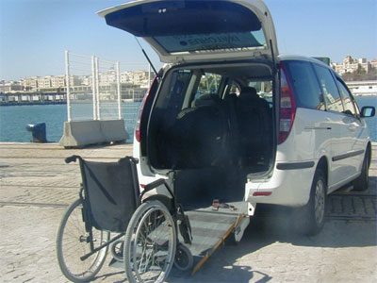
Developing the tourism supply chain:
…the 4 essentials
Accessible…
Transport - vehicles, terminals,
transfers, assistance…
…throughout the entire delivery chain

Slide 13
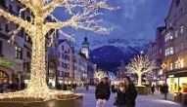

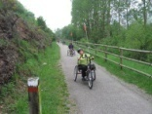

Developing the tourism supply chain:
…the 4 essentials
Accessible…
Infrastructure - attractions, accommodation
restaurants, streets, beaches…
…throughout the entire delivery chain

Slide 14
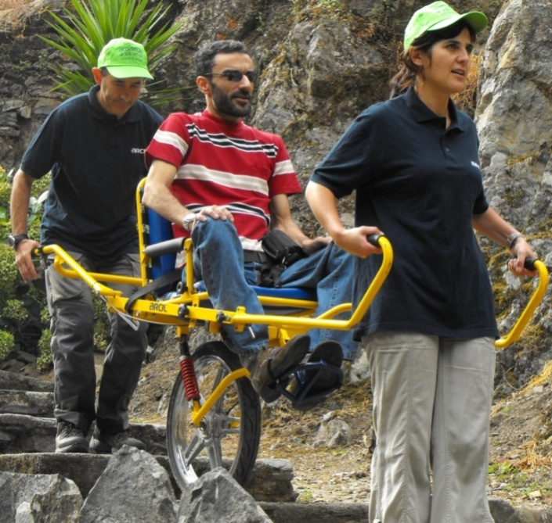
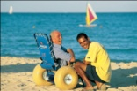
Developing the tourism supply chain:
…the 4 essentials
Accessible…
Services
- hospitality, packages,
tourist guiding, excursions,
special menus, activities, technical aids,
personal assistance…
…throughout the entire delivery chain
Notes:
.

Slide 15

The Accessible Tourism
Supply Chain
“A chain is only as strong as the weakest link...”
Information
eat, sleep
arrival
shopping
local transport
visit attractions
departure

Slide 16

The Accessible Tourism
Supply Chain
Information
eat, sleep
arrival
shopping
local transport
visit attractions
departure
If just one link in the chain is broken (inaccessible) the trip will be spoiled...

Slide 17
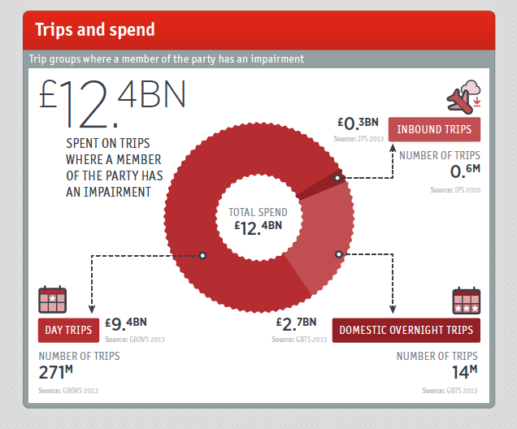

Accessible Tourism Market Opportunities - England
Accessible Tourism spend: £12.4 BN
Source: VisitEngland

Slide 18
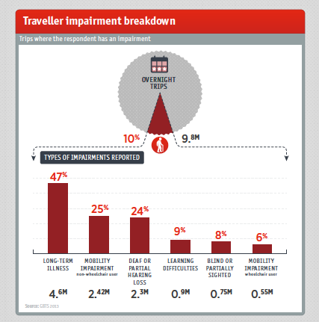
Accessible Tourism Market - England
Which disabilities?
Visitor Survey (2013)
- groups where one of the members has a disability or long-term health condition
Source: VisitEngland

Slide 19
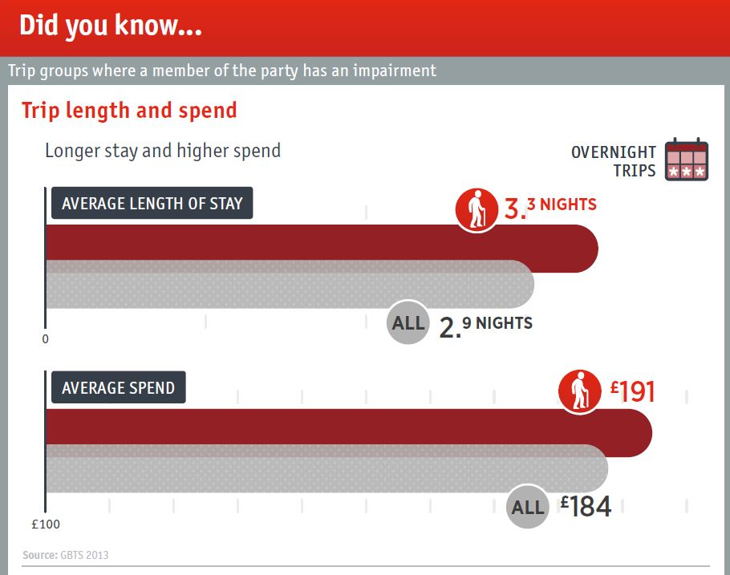
Accessible Tourism Market - England
Stay longer
Spend more
Source: VisitEngland

Slide 20
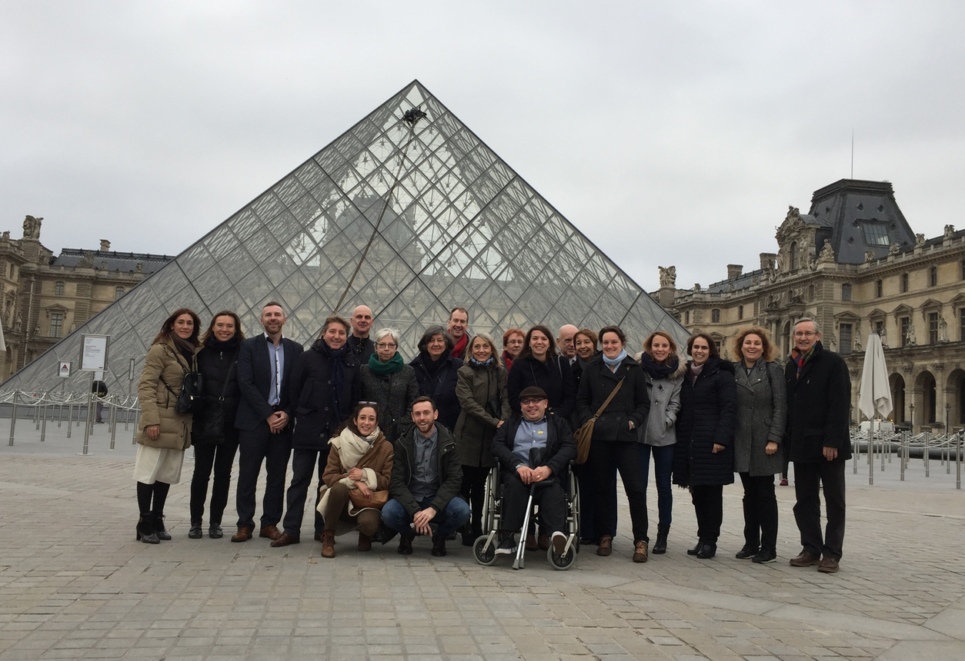
ENAT Members – the NTOs’ Learning Group
ENAT Members – select group made up of the leading National and Regional Tourist Authorities in the accesible tourism field
Annual Meeting (Edinburgh 2016, Paris 2017, ??? 2018
Exchanging experiences
Sharing best practices – policies, strategies and actions
Developing common tools and methods (e.g. Visitor Surveys)
MoUs, projects , Cooperation, Study Tours

Slide 21
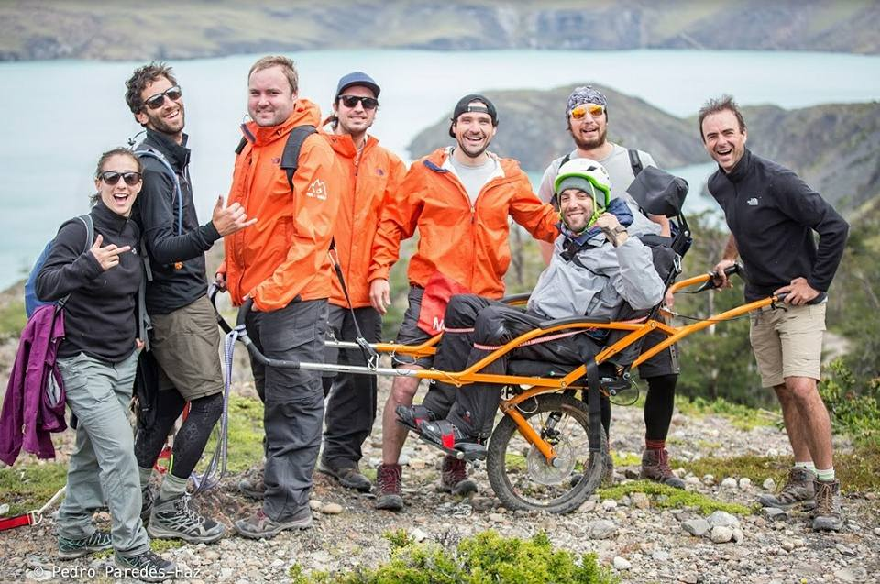

Accessible Activities at the Destination
Accessibility from start to finish….
Ensuring an inclusive experience for All
Notes:
21

Slide 22
Visitors
Businesses
Destinations
Win
Win
Win

Slide 23

Thank you
enat@accessibletourism.org
www.accessibletourism.org
@EUaccesstourism
@pantou_org

