Slide 1
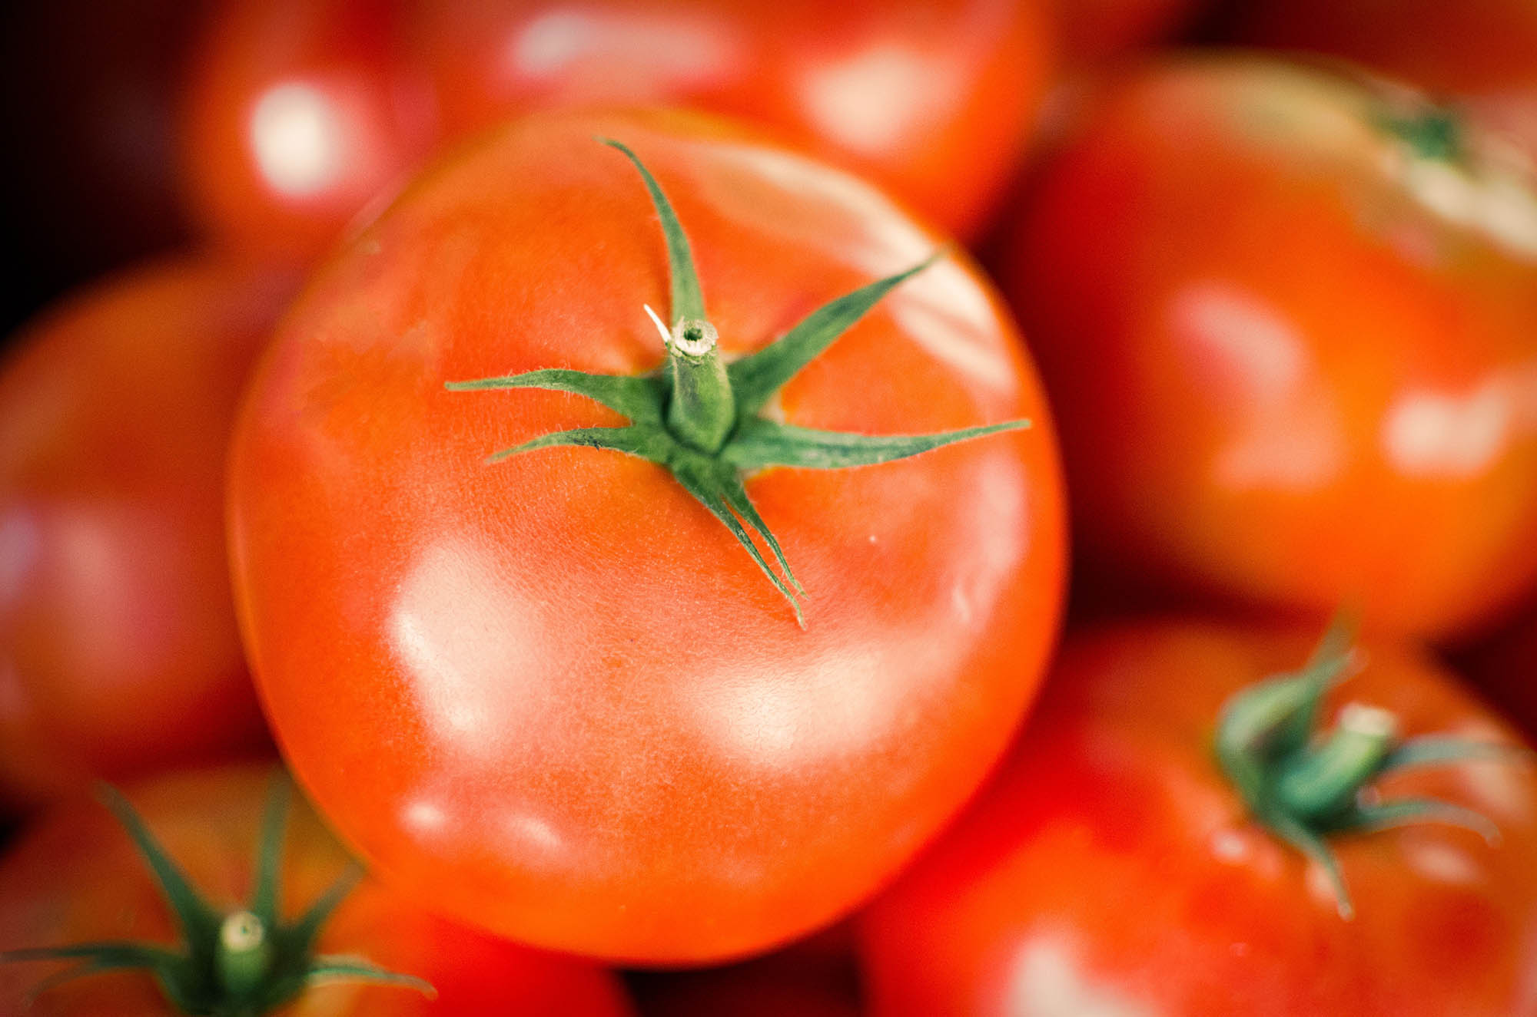

Slide 2
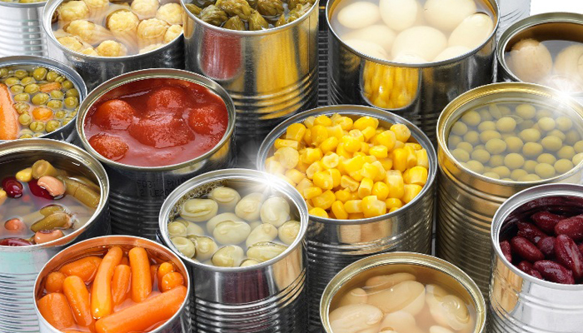
INITIAL PROBLEM
OUR MISSION.
Increase of chronic deseases due to industrial and processed food and use of chemicals and pesticides in intensive farming
Global Panel on Agriculture and Food Systems for Nutrition

Slide 3
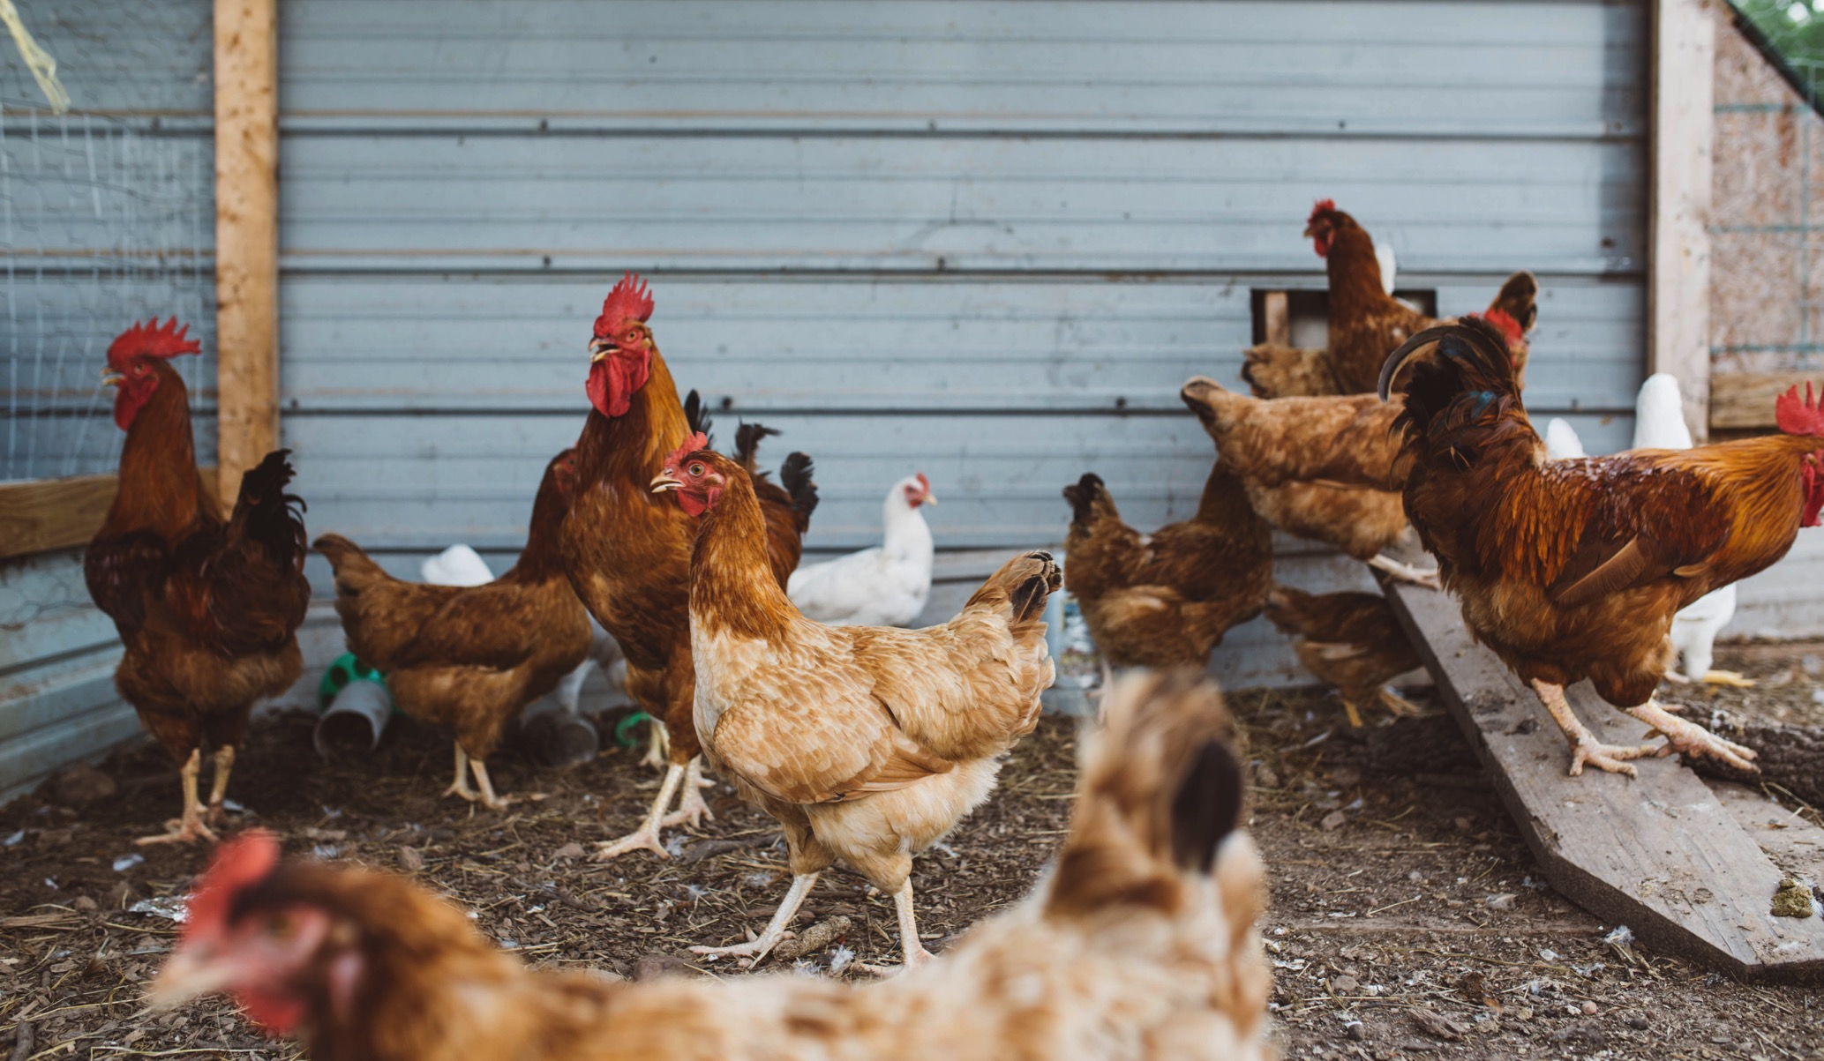
INCREASING DEMAND
OUR MISSION.
local, organic and fresh produce, direct from producer,
recently harvested
Growth has increased 22% more than conventional produce - IRIWorldWide

Slide 4
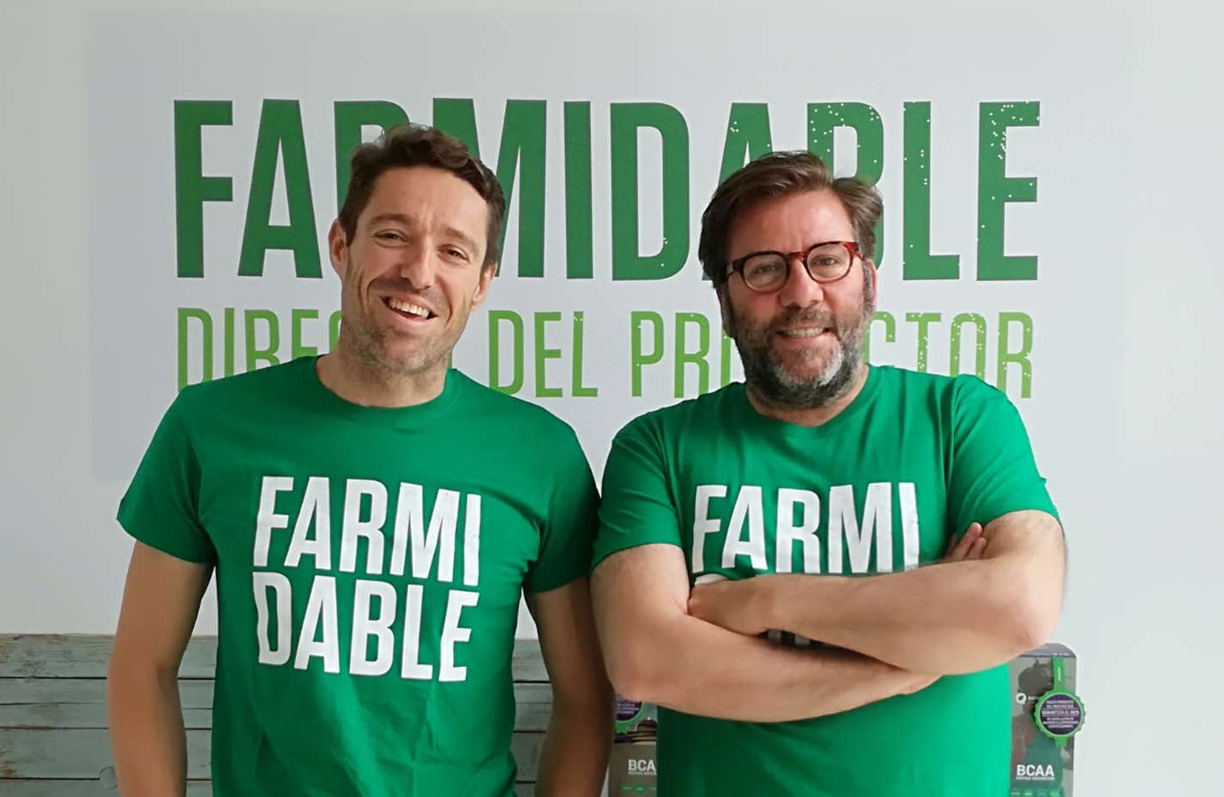
PABLO
STÜRZER
45 yo. Entrepreneur, BS Industrial Psychology, with more than 25 years of international experience, in R&D, Marketing, Functional Design and UX in apps and IT platforms and TELCO. He has an extensive experience in digital start-up projects, founder of blablaweb, motovitae, agendit,, expert in design, online marketing, social media, and ecommerce. Founder of 4One, one of the first online digital agencies in Spain during 14 years, sold to start Farmidable up. A natural optimistic motivator, speaking spanish, english, german still learning french, who loves sports and nature.
ALBERTO
PALACIOS
48 yo. Entrepreneur licensed in Politics and Sociology by UCM, Master in HR by UNED and Master in Marketing by ESIC, has developed his career in internet and telecom multinationals. Founder of 4One, spanish leading online digital agency, for more than 12 years sold to start Farmidable up. Part of several social project “Arte y Cera SL” and “Asociación para el Desarrollo de la Pedagogía Curativa y Socioterapia de Rudolf Steiner”. Foodie, creator of several consumer groups and obsessed with farmers markets.
Over 25 years of experience in food, marketing and e-commerce

Slide 5
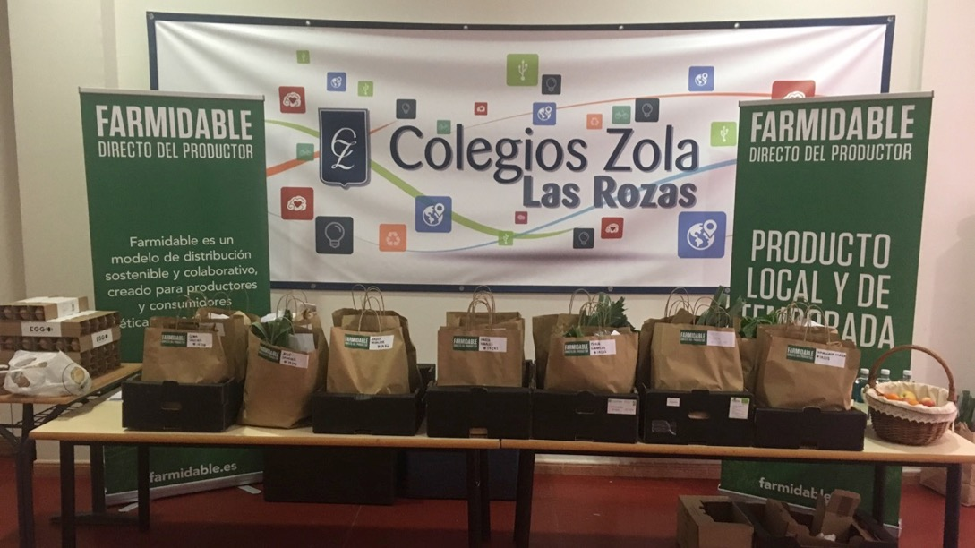
WHAT WE ACHIEVED
OUR MISSION.
CREATED
the first delivery platform of recently harvested & fresh produce, through a human communities network and door-to-door service
(schools, workplaces, gym, ...)

Slide 6
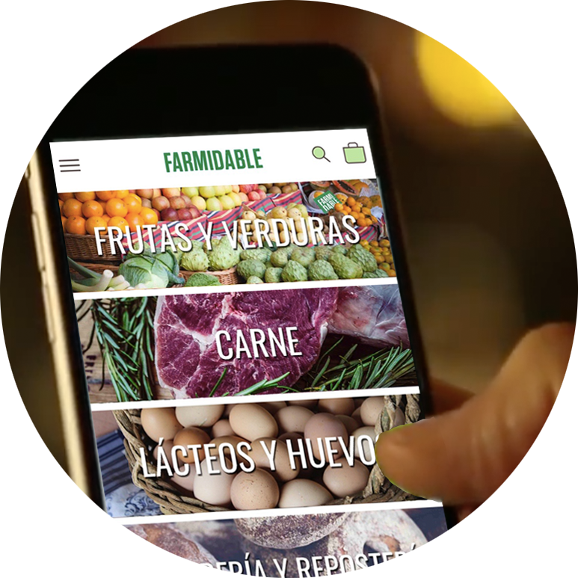
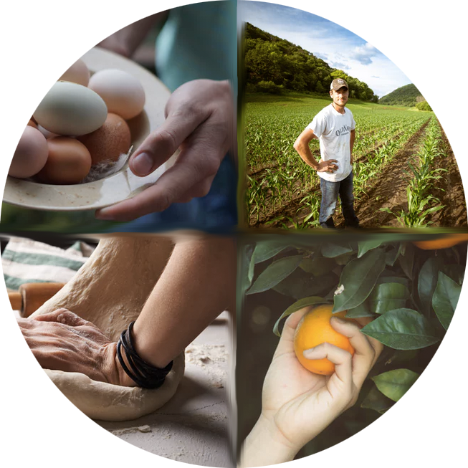
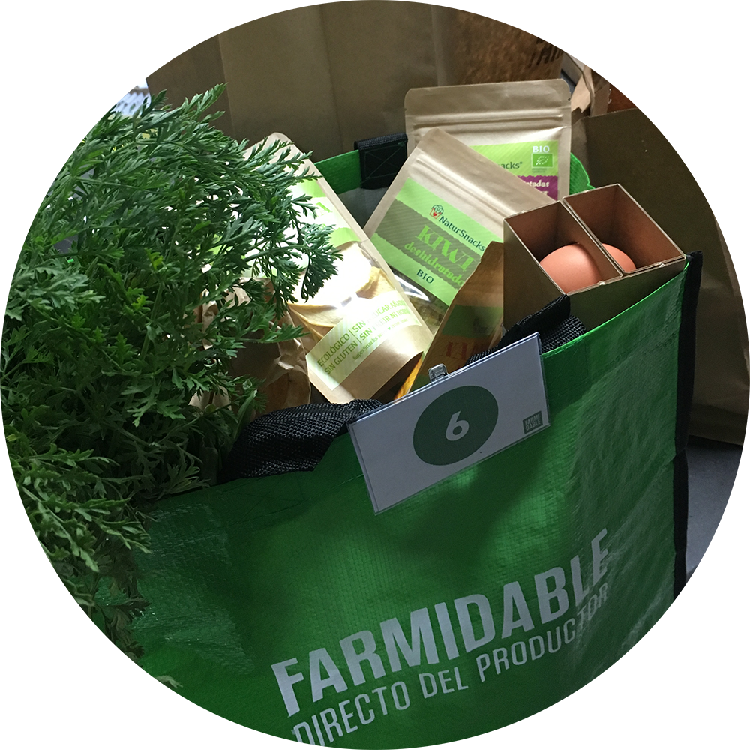
HOW WE DO IT
Consumers buy online
via mobile App / web
Producers deliver to
our central hub in 24H
Consumers collect or
Receive home
Our platform sends daily orders to producers
FarmiVan
Multidelivery

Slide 7
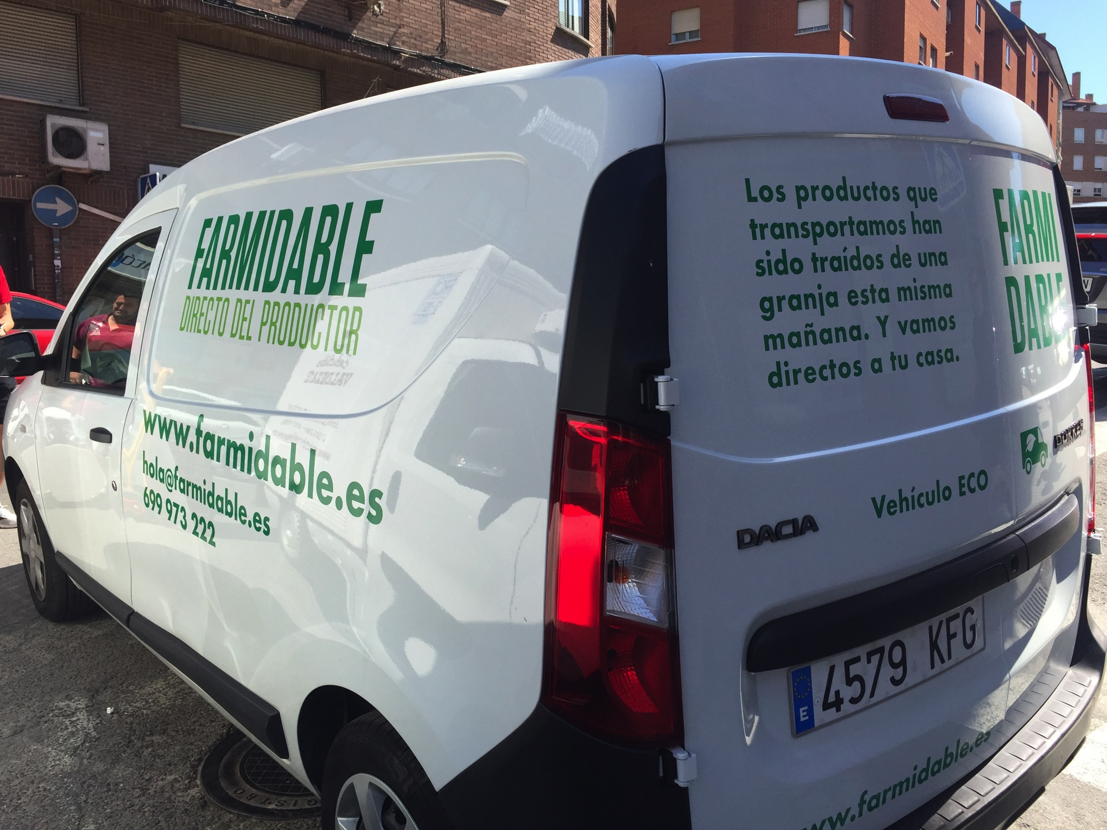
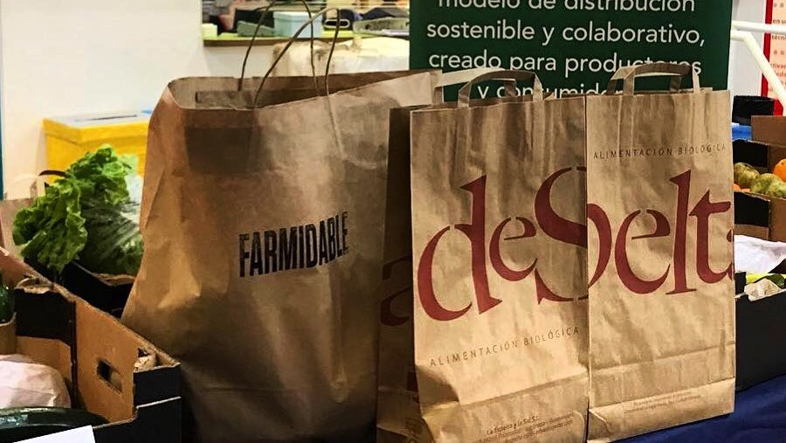
COMMUNITIES AND MULTIDELIVERY – UNIQUE MODEL
Source our stock on demand, based on consumers orders,
and arrange sustainable multidelivery for consumers to collect at SCHOOL when picking up kids, at WORKPLACE when leaving,
or to receive it HOME in 24H.

Slide 8
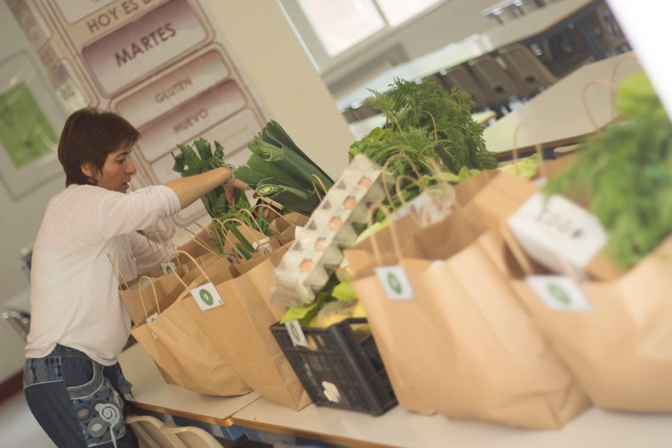
POSSITIVE IMPACT
TEAM
Produce arrives at our logistic HUB on a daily basis, and Yolanda, Aurora and Teresa, pick & pack consumers orders, to be delivered to each Farmidable community or any other final destination

Slide 9
2017
2018 (estimate)
OUR IMPACT
Farmidable Communities
Consumers (73% recurrent)
Producers Sales
Orders
Tons of Local Produce
Average Ticket
Jobs Created
17
25
+2000
+1000
+100.000€
+160.000€
+4500
+3000
+70
+40
40€
33€
2
5

Slide 10
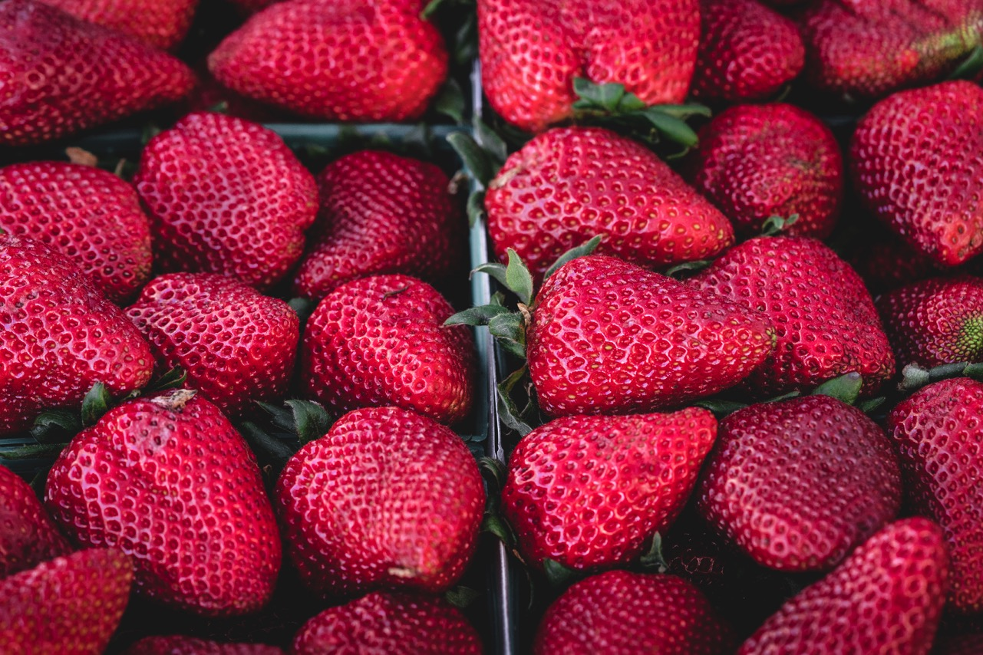
A FARMIDABLE WORLD IS POSSIBLE ;)
pablo@farmidable.es
farmidable.es
facebook.com/Farmidable
instagram.com/farmidable_es
twitter.com/farmidable_es

